Slide 1
Welcome!
#0

Slide 2
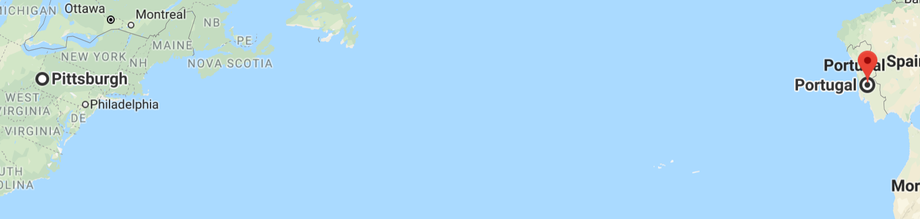
Welcome!
My name is Luís (pronounced Loo-eesh, but I don’t really care ☺ )
I’m not from these parts as you can tell from my accent
I come from Portugal
course site: luisfnqoliveira.github.io/CS0007
all the stuff I talk about today is on the course site
email: loliveira@pitt.edu
office: 5421 SENSQ (haha – more like Zoom) (check site)
office Hours: TBD (check the site)
i before e except after c…
and this guy’s name!

Slide 3

Textbook
Starting out with Java From Control Structures through Objects
7th edition
If you have a previous edition it’s fine
If you have another book on Java, check the table of contents
I advise you to get a book on Java
You have been opted-in in Redshelf (It’ll cost you $)
You can opt-out until add/drop (check website)

Slide 4
Grading
Classes are important
Some will be boring (today? ☺)
Sometimes the slides alone may not be clear enough
Even from seasoned professors! (I know, I’ve been there!)
Labs: 20%
Work done during recitation
Quizzes: 10%
In recitation
3 projects: 30%
Programming projects using Java
2 exams: 40%
1 midterms, 1 (semi-cumulative) final
Lowest grade 15%; highest is 25%

Slide 5
Expectations
Religious absences are excused: contact me ASAP
Students with disabilities should contact the Office of Disability Resources and Services (DRS) if you haven’t already
216 William Pitt Union; 412-648-7890; TTY:412-383-7355
Please, no comments about sex, gender, race, ethnicity, religion, etc..
Anywhere!
Just be nice!
Cheating: Don’t!
0 on assignment first time,
fail the course second time.
Do not publish your work in public palaces (no github!)
you can also talk about labs, but still no sharing stuff

Slide 6
DO NOT CHEAT!
If you're confused, don't cheat, ask me for help?
Hot tips for not cheating:
Don’t!
Do not!
You have LOTS of resources
Me! and the TA
Undergraduate Helpdesk (CRC)
People can tell when you cheat
It is usually quite obvious!
So don’t do it, it’s not worth it!
The university is quite strict about it.

Slide 7
Teaching
No questions are dumb!
NEVER BE AFRAID TO ASK THEM!
DON’T STRUGGLE IN SILENCE ON YOUR PROJECTS!!!!!!!
Classes taught without interaction are boring!!
I cannot read your mind, or see your faces (remote \o/)
Interrupt me!
You can ask questions, and get the answers promptly!
Please… be interactive ☺

Slide 8
FAQ
Maybe the answer for my question is in the next slide. Should I ask?
Yes! I’ll let you know if that’s the case
I’m sure I should know this. I shouldn’t ask!
NO! Probably you should not know that yet! So just ASK!
NO! Maybe you should know, BUT you don’t… So ASK!
I’m embarrassed I don’t want to ask
That’s fine! But don’t be! Others will have the same question! I assure you!
But if you want, write the question down, send it to me privately!
BUT ASK!!!! (later)
Should I ask?
YES! Interrupt me at any time!!!
Like now? INTERRUPT ME!!!

Slide 9
Goals for this course
Think computer:
Understand common programming grammar (usage and limitations)
Create a solution for a problem (this is the actual hard part!)
Practice-practice-practice
Read computer:
Analyse and critique Java code written by someone else
Looking at code and understand what’s going on!
You will need to understand other people’s code
Speak computer:
Write algorithms and implement them (in Java)
Binary – and how does it limit us when writing a program
Programming – How to convert a solution into something the computer can do

